Slide 1
Automation Fieldbuses
Practical examples
03/05/2016

Slide 2

INDEX
0 – who we are …
1 – Aveiro Harbour
Needs
Solutions
Simple and scalable
2 – Fieldbus in CUF
Why
How
Time management in FF
Anatomy of a FF device
Hacking with FF
3 – Remote internet access to a smart FIELD device
ET phone home …

Slide 3
0 – Who we are
José de Mello, SGPS
BRISA
Mobility, infrastructures and highways
CUF
Chemical industry and nanostructed materials
JOSÉ DE MELLO SAÚDE
Private health facilities and public-private partnerships
MONTE DE RAVASQUEIRA
Wine production and commercialization
JOSÉ DE MELLO RESIDENCIAIS E SERVIÇOS
Residential solutions for seniors and rehabilitation programs
MGI CAPITAL sgps,sa
Industrial maintenance and photovoltaic parks

Slide 4
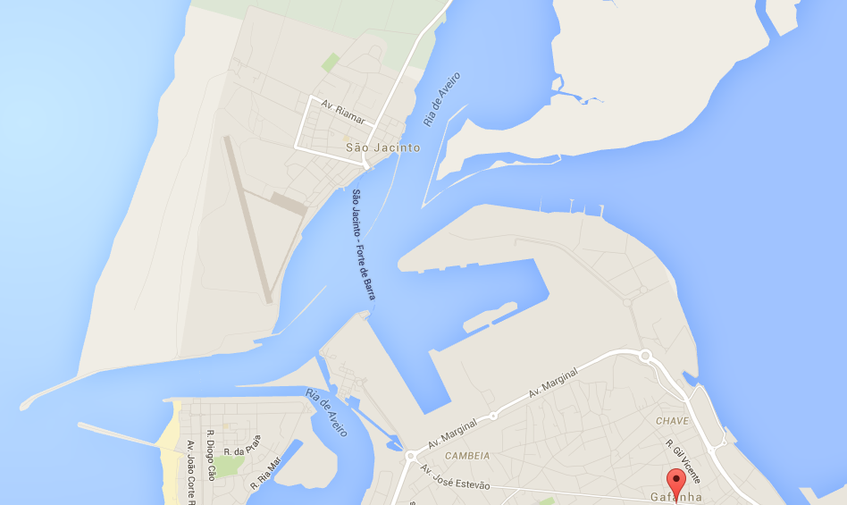
1 – Gafanha da Nazaré, Harbour

Slide 5
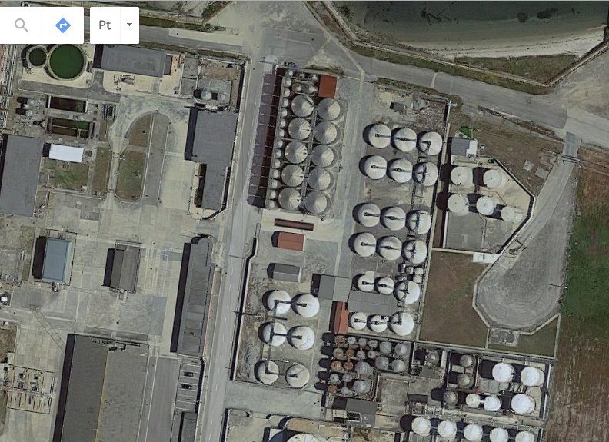
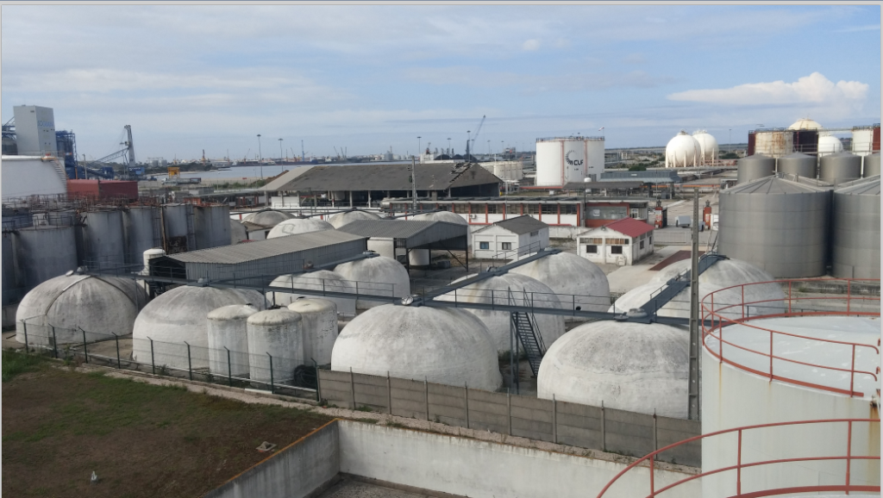
1 – Gafanha da Nazaré, Harbour
Client’s needs …
Tank Stock levels
Security cameras

Slide 6
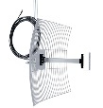
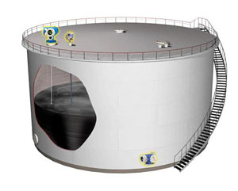
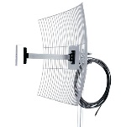

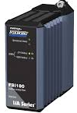
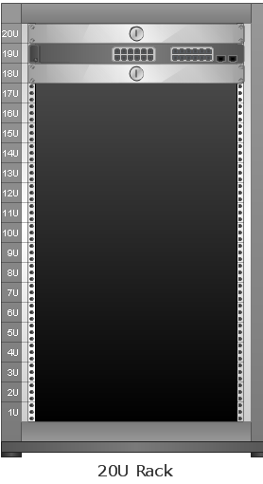

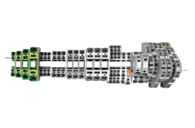
1 – Gafanha da Nazaré, Harbour
Proposed solution
Directional Antenna
Omni Antenna
Line of sight 200m
Ethernet card
+
modbus driver
Multiple 4-20 mA signals
MODBUS TCP
Switch 24 ports Gigabit c/VLAN & POE
PLC Schneider STB Modbus TCP (Remote IO, no logic required

Slide 7
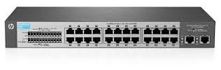
1 – Gafanha da Nazaré, Harbour
Traffic management
VLAN 1 – Video TCP Data
VLAN 2 – Modbus TCP Data
MB/s of data (millions of bytes per sec)
B/s of data (some bytes per sec)
Continuous data flow
Every couple of seconds
Fast protocol
Modbus is a slow protocol, either RTU or TCP.
But speed is not an issue in this case
VLAN limited to 80% bandwidth
VLAN not limited.
Does it require 20% bandwidth ? No

Slide 8
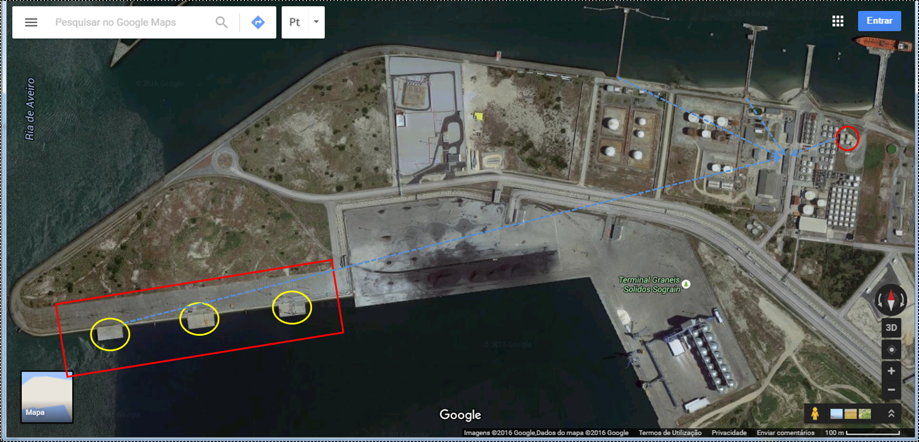
1 – Gafanha da Nazaré, Harbour
Simple and scalable
Future Loading Docks
Security cameras

Slide 9


2 – Fieldbus in CUF
Why ?
Stick with 4-20 mA
  Pre-made engineering
  Well know problems
  Standard
  Engineering companies lobby heavilly in favor of 4-20mA
Evolve to a digital protocol
  Promises of:
    Less cabling
    Reliable signals
    Equipment diagnostics
    Configuration and flexibility over field devices
  Engineering and startup a lot more complex

Slide 10

Fieldbus in CUF
In 2007 there were not that may choices available.
Chose Foundation Fieldbus (FF)
Has some features that exist in the analog world (4-20mA) and adds some additional benefits.
Similarities
- Loop integrity
- Standard cabling
- Bus powered instruments
- Fitted for Intrinsic Safety (IS) electrical certification
Additional Benefits
  1- More functionalities by using digital communications
  2- Less cabling – several devices on the same pair.
  3- A lot less connections in the IO cabinets.
  4- The field instruments behave like devices on the control network, with online diagnostic.

Slide 11
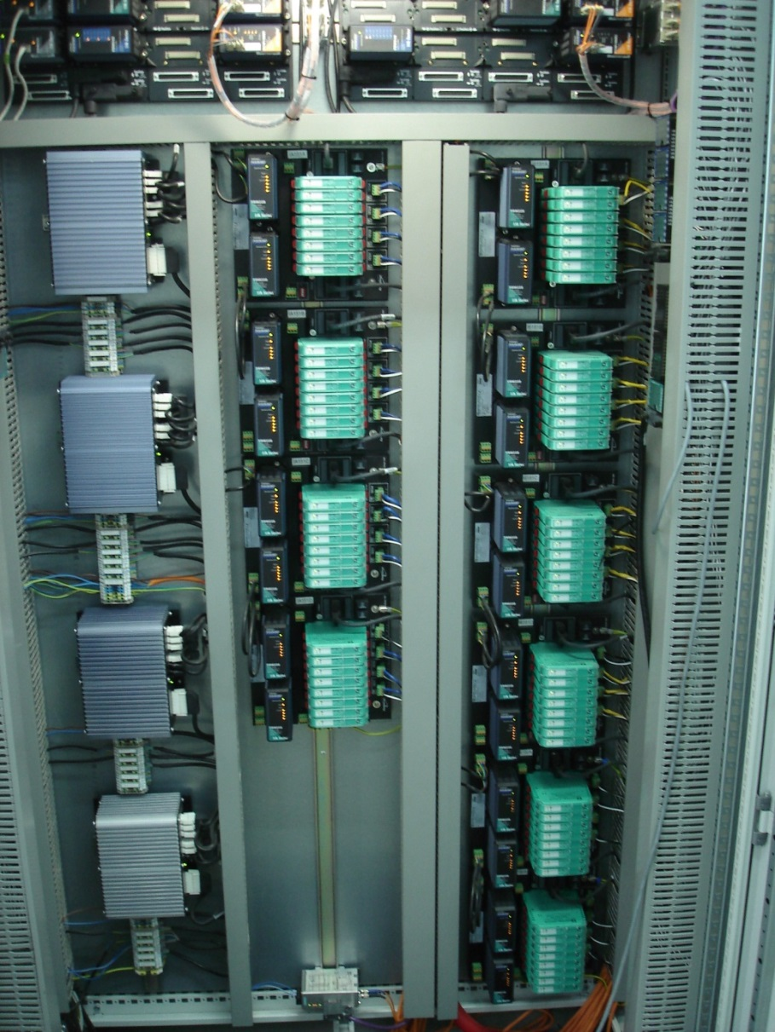
Fieldbus in CUF
How – the hard part
1 Fieldbus Foundation Cabinet
2 redundant cards per base
4 segments per base
2 power conditioners per segment
2 power supplies per base
Total :
  38 segments / cables
  276 devices

Slide 12
Fieldbus in CUF
FF

Slide 13
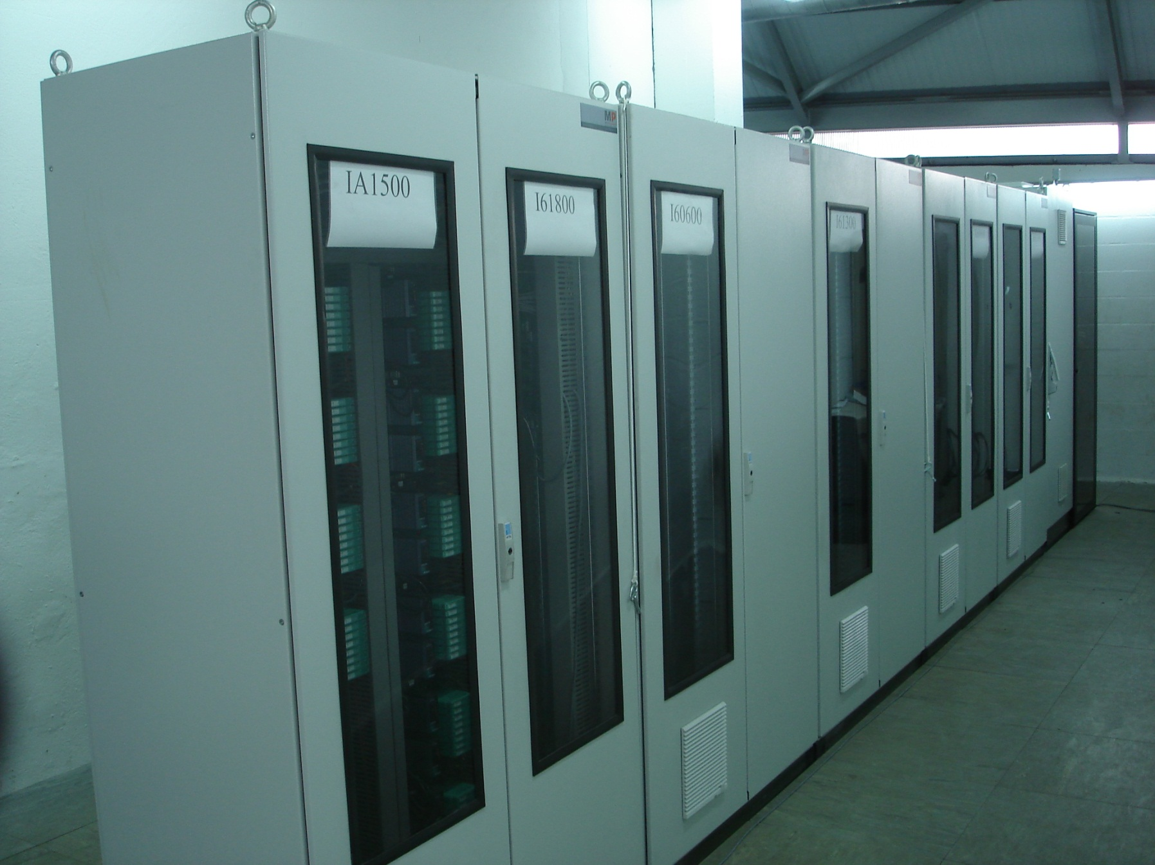
Hardware
600
1200

Slide 14
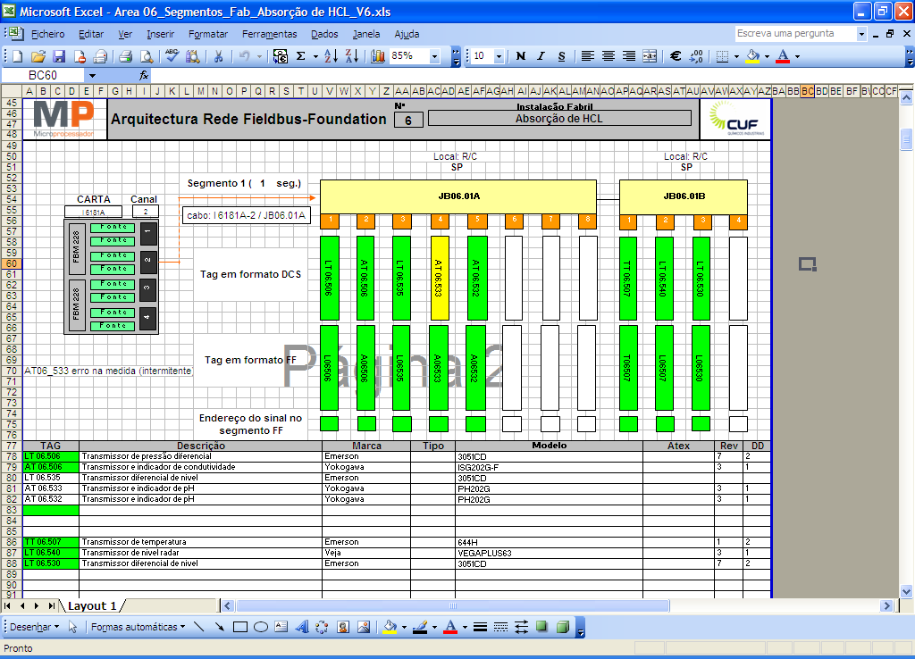
Hardware

Slide 15
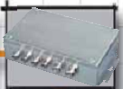
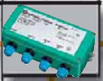
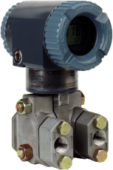
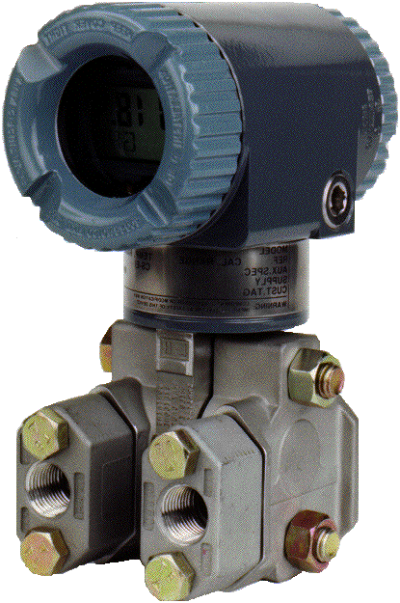
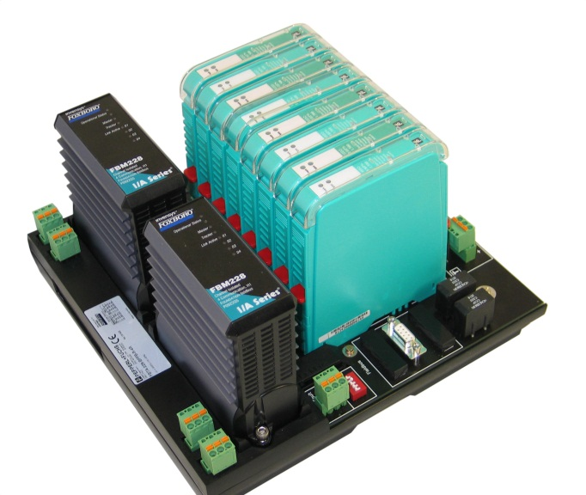
Hardware – Types of field boxes
Segment Protector (SP)
Field Barrier (FB)
“High Current”
High Current
“Low Current”
Ex d Device
Ex ia Device
Fire is contained within the body
Unclassified zone
High current up to the device
Allows bigger distances
Isolated instruments, one output does not affect the others
Does not get enough current to generate a spark
Classified zone (ATEX zone 0/1/2)
Fewer instruments per box
Shorter distance to the device
More expensive solution

Slide 16
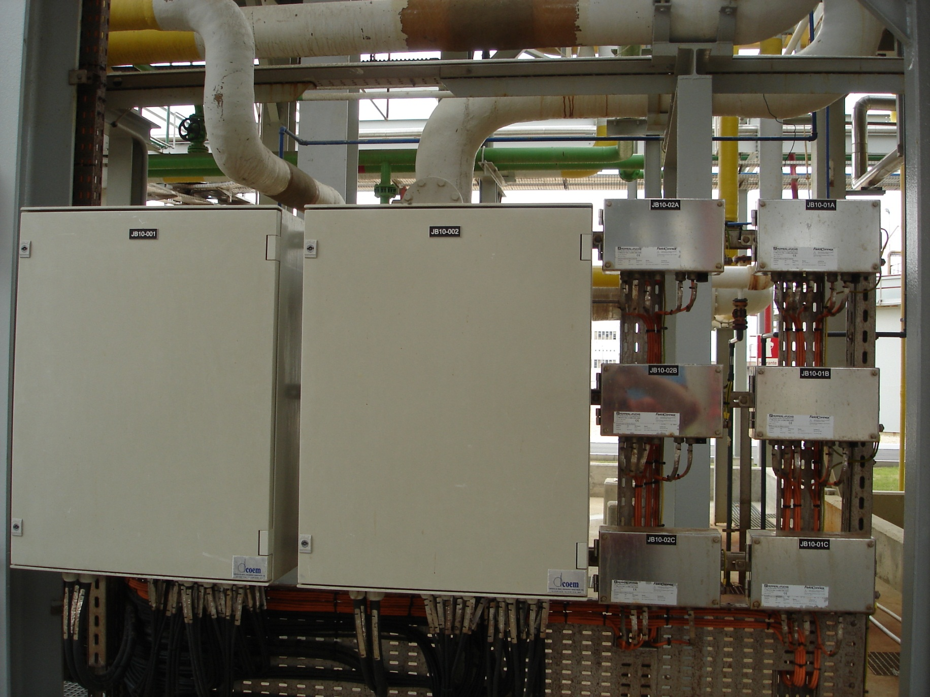
Hardware

Slide 17
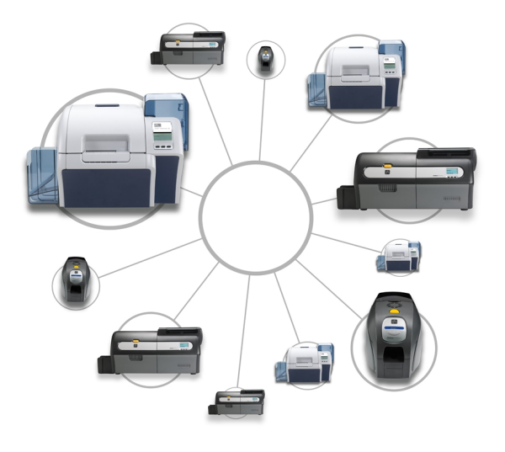
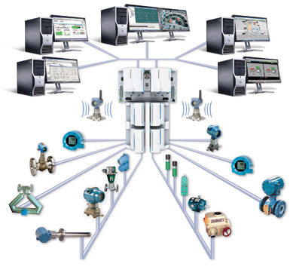
Software
Getting things to work
Printers on a network
need specific drivers to work
Fieldbus devices on a segment
need specific drivers to work
Must match brand, model and revision

Slide 18

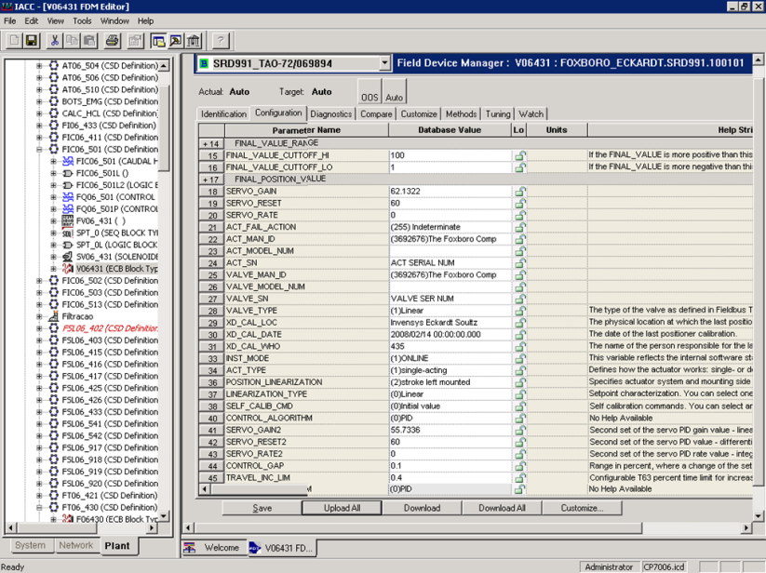
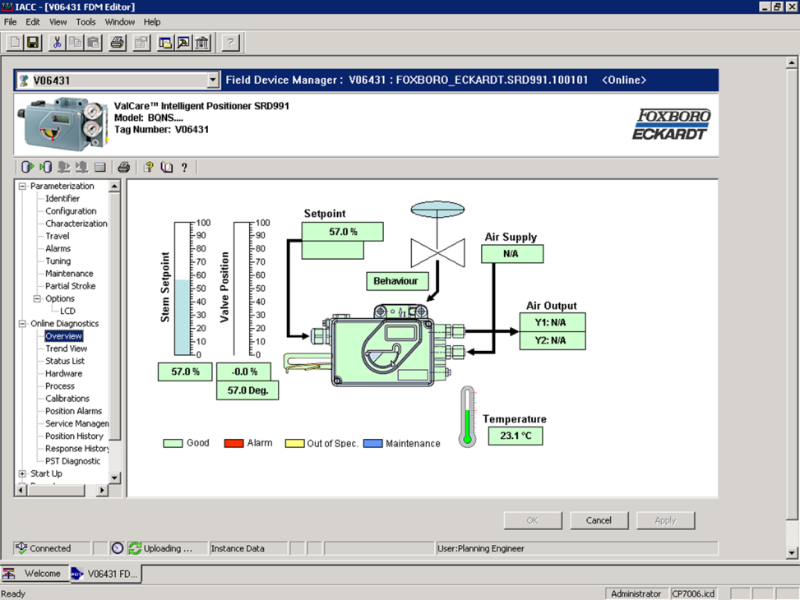
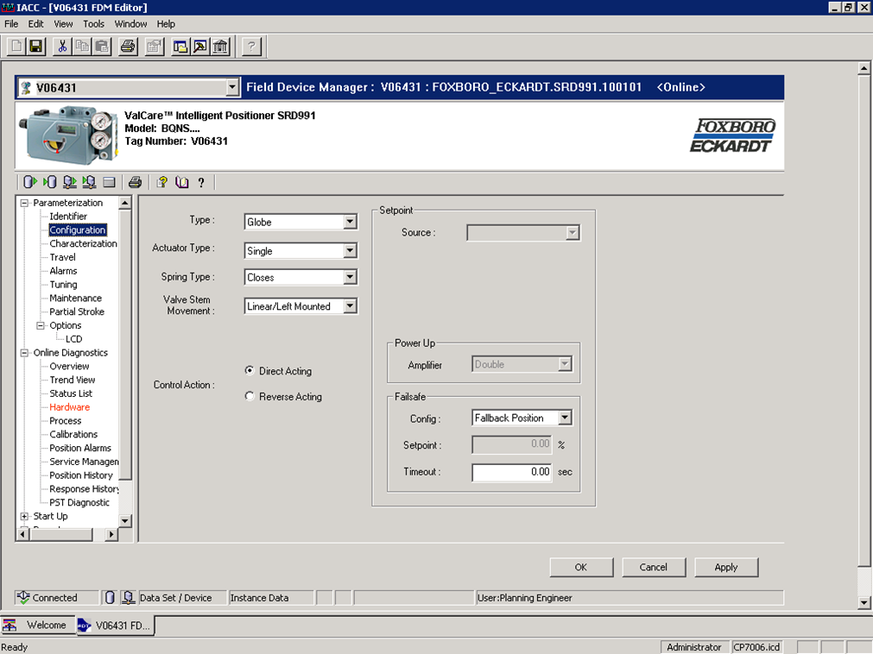
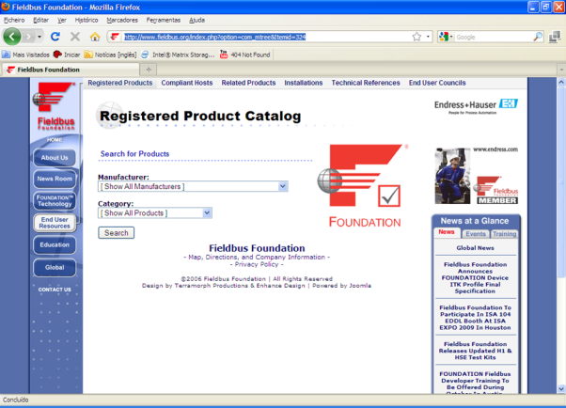
Software
Device drivers
FDT tecnology – DD – Device Descriptors
Text files that describe with a pre-defined syntax the characteristics and capabilities of the devices
DTM – Device Type Manager
Compiled DLL that can be installed on the host and provides graphical access to the inner workings of the device

Slide 19
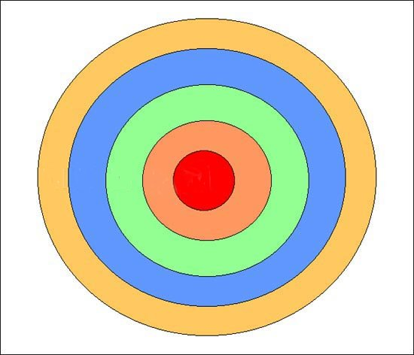
Software
DTM Files
FF Devices
Some brands
Some Models
Provide DTM’s
Work

Slide 20
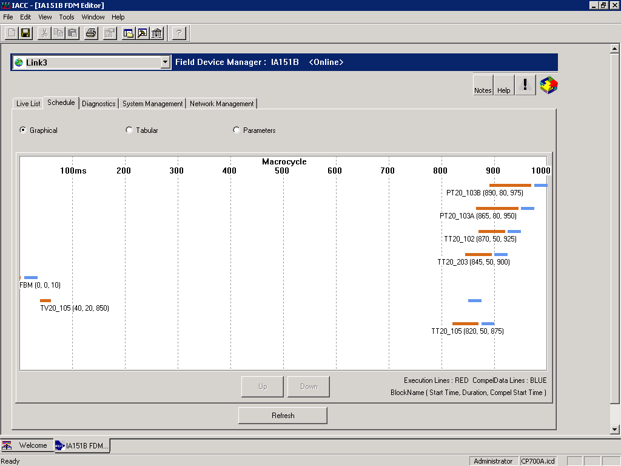

Software
Time Management in a FF segment
Free time for other operations
Uploads, Downloads, alarms, additional variables besides the official ones.

Slide 21
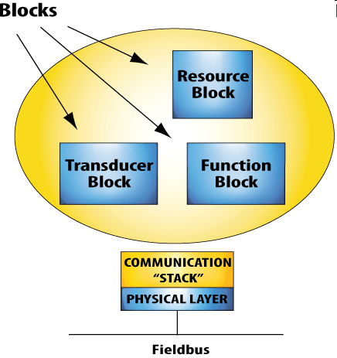
Software
Anatomy of a FF Device
CPU
1 per measurment sensor
1 per variable

Slide 22
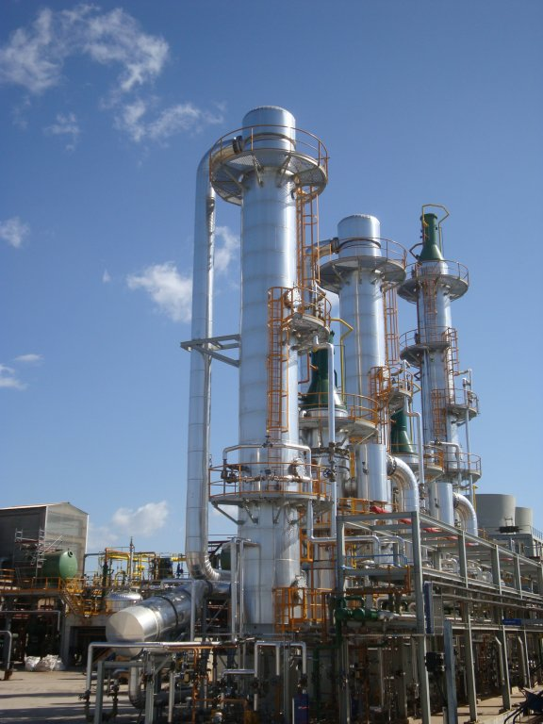
Software
Transmitters & Sensors
FF Sensors scatered
throghout all stages
FF CPU’s (transmitters) at
the ground flour level

Slide 23


Software
Sensor capabilities
Conventional 4-20mA
Fixed ranges, calibrated. Hard limits
Field bus device
The sensor is CAPABLE of measuring from -20 to 200ºC. We can choose any range within that.
If the temperature goes outside the select range, the device keeps measuring normally (maybe with a warning of “outside expected range)
20 mA = 100 ºC
4 mA = 0 ºC

Slide 24







Software
Importance of dynamic scaling
Up to 150 Kg max
This plant is actualy
8 stores high …
300 Kg pig
2 days after startup

Slide 25
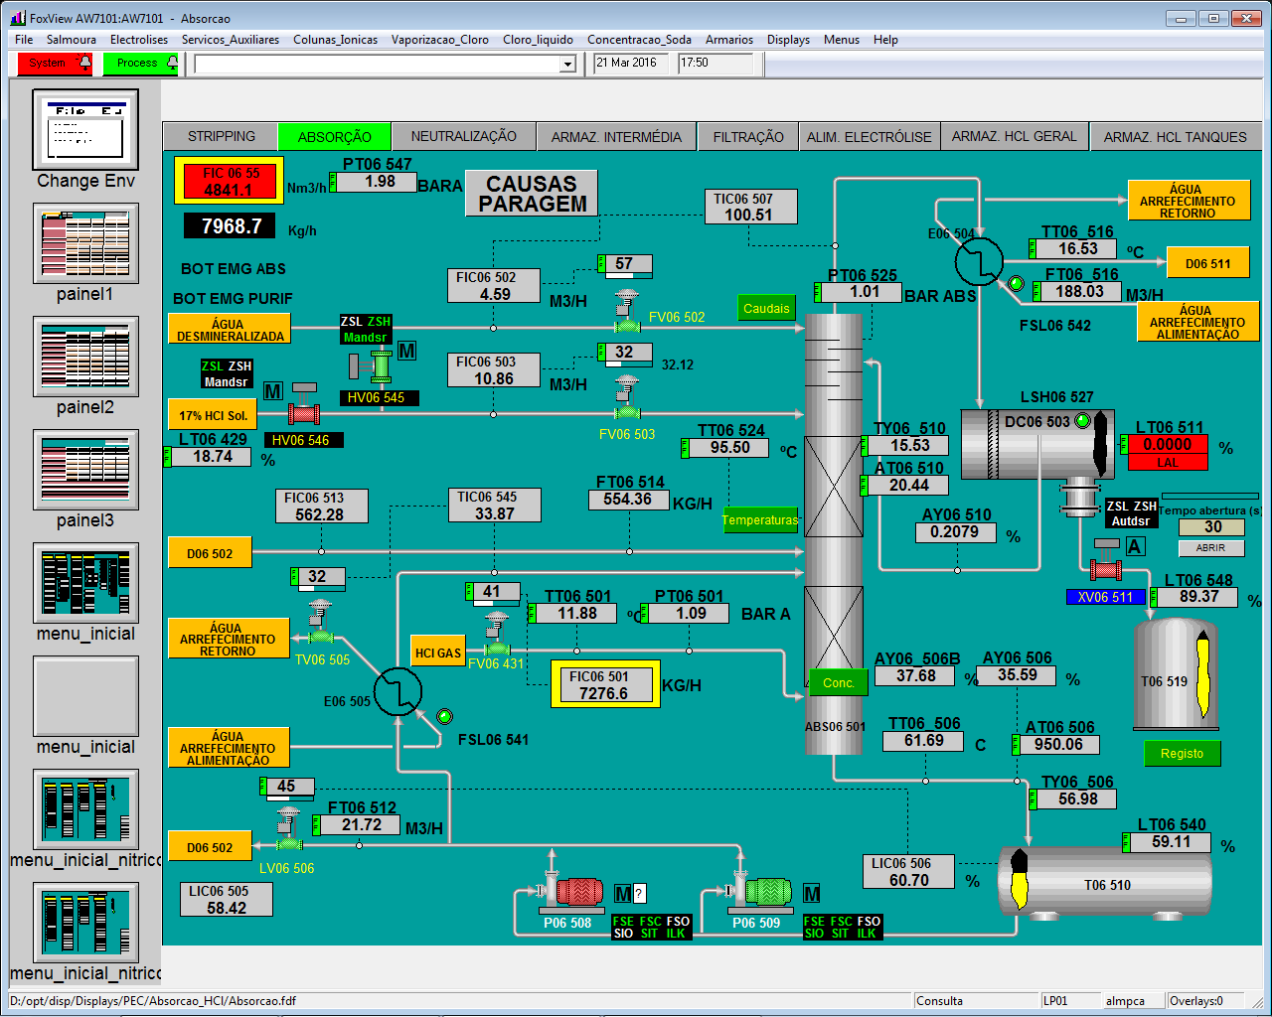

Software – Comparing with reality

Slide 26
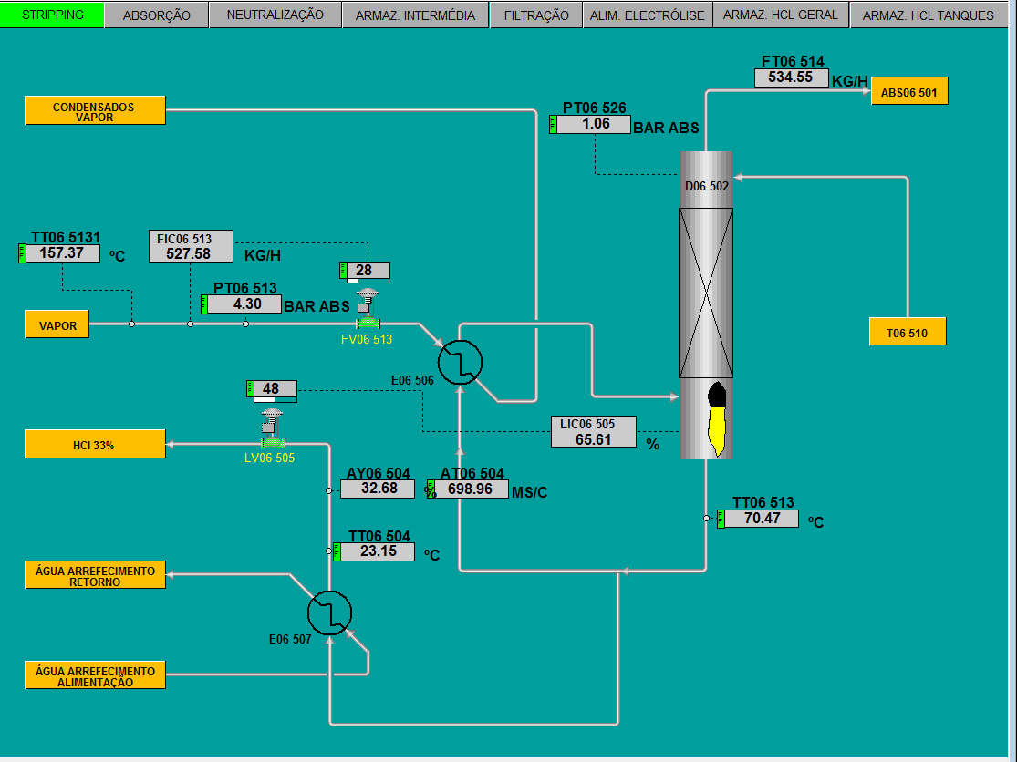

Software – Comparing with reality

Slide 27
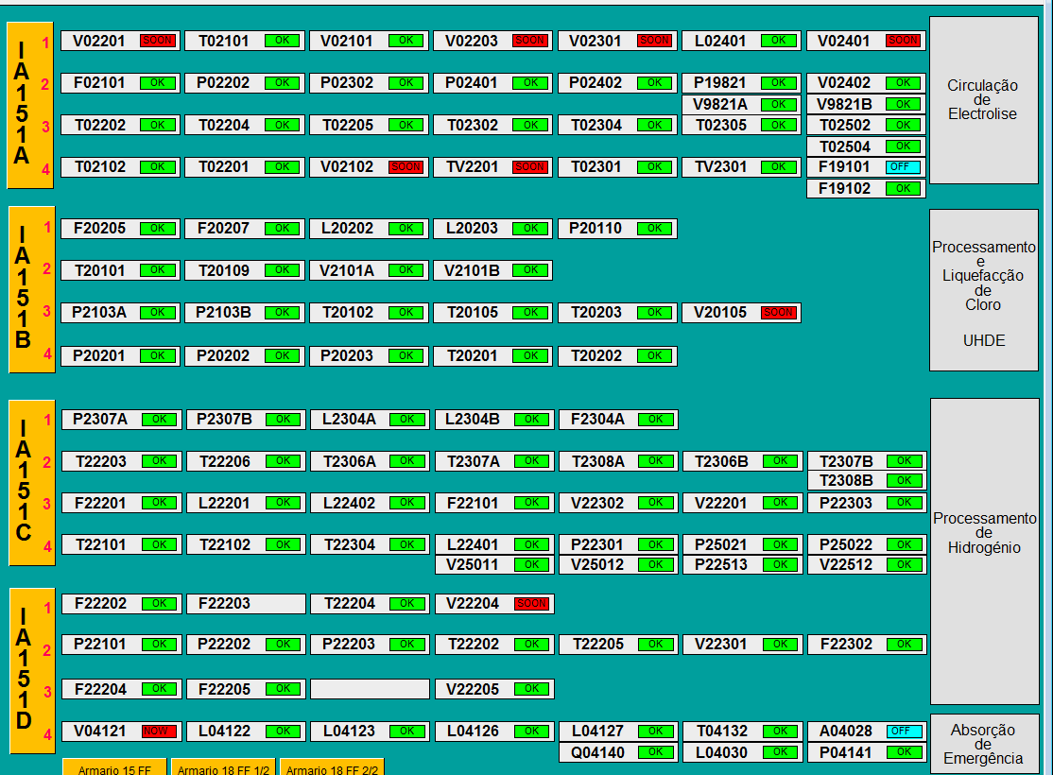
Software – Birds eye view of ff devices
NoW

Slide 28
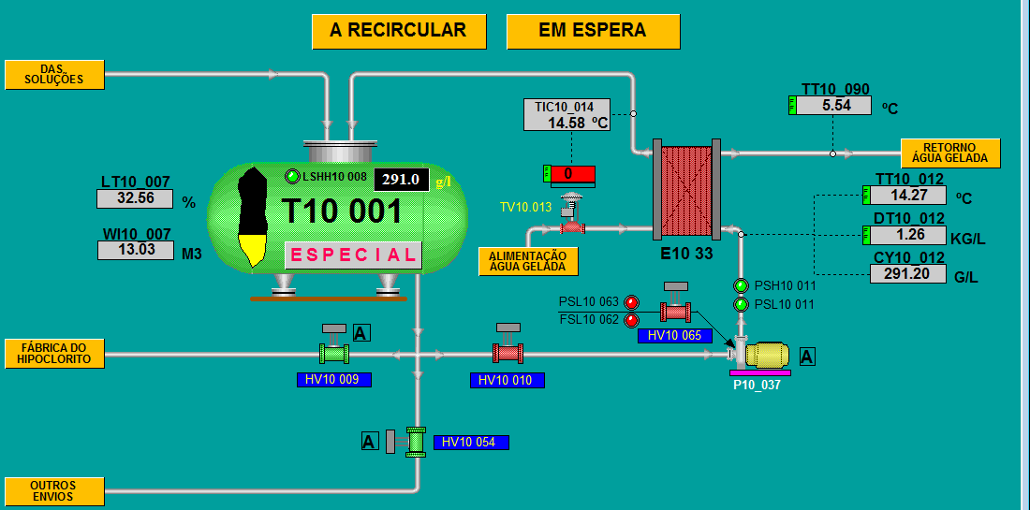
Hacking with a FF device
Thinking outside the conventional
Mass Flowmeter
An analyzer is expensive. A small mass flowmeter is a lot less expensive …

Slide 29


3 – Remote internet access to a smart FIELD device
ET PHONE HOME - NO
But Home can call ET, as long as we
are listening in on the call.

Slide 30

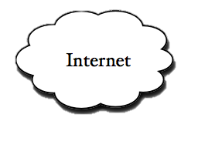
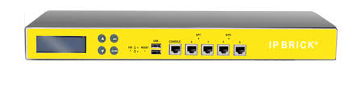

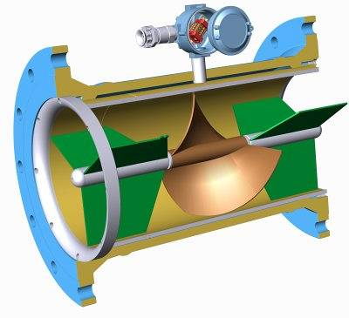

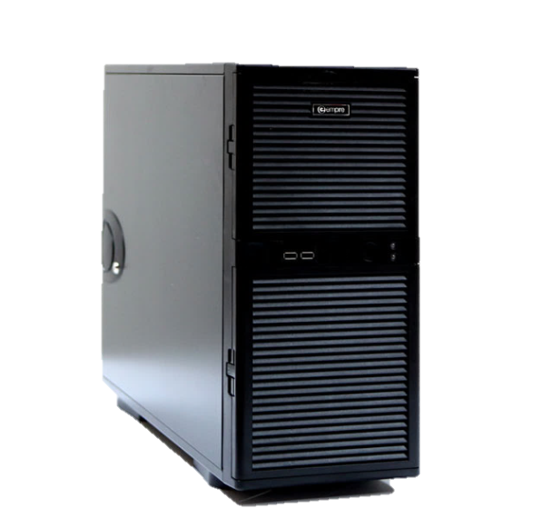
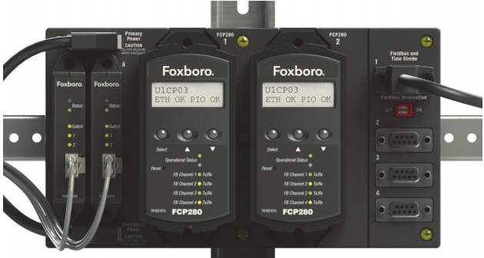
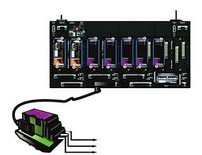
Remote Acess
No need to send device to manufacter
Security certificate
User & Login
Security Firewall
Enable user
Office Laptop
Share screen
Field
DCS Server
DCS CPU

Slide 31

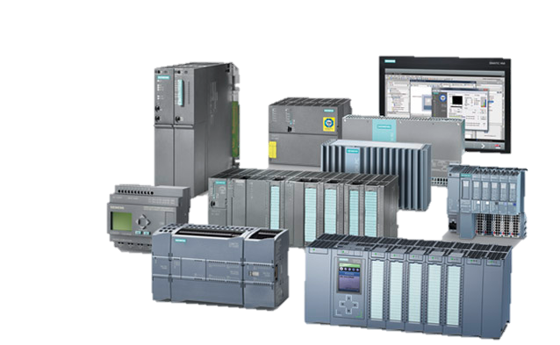
Remote Access
Remote access to auxiliar systems
Security certificate
User & Login
Security Firewall
Enable user
German Company
Activate/deactivate
Gateway function at
the Firewall for this ET
Auxiliar System
PC

Slide 32

Questions ?

Slide 33
THANKS

